Slide 1

GCCISD Agreement for Computing and Electronic Communications
Elementary

Slide 2

As a technology user in GCCISD you are responsible for the following:

Slide 3
How Do I Login?
Username: your ID#
Password: your Birthdate (01012001)

Slide 4

Password
Keep it private.
Do not let anyone use your username and password.
You are responsible for all actions while logged into your account.

Slide 5

Username / Password
If you think someone knows your username / password, immediately report it to one of the following:
  CTS
  Librarian
  Classroom teacher

Slide 6

Log Off…
Make sure to log off
  Laptops
  Computer lab computers
  Classroom computers
when you are finished with your work.
*Remember to also click Log Off in the popup box.

Slide 7

iPads
Expectations for using an iPad
  clean hands
  be gentle
  follow directions
  respect others’ work
  only open assigned app
  close app after use
By swiping right, I agree to follow these expectations

Slide 8

Cyber Bullying
Includes text, images, audio, or video that
  defames
  intimidates
  harasses
  harms
  insults
  humiliates
others in an unwanted manner.

Slide 9

Misuse
Misuse of computers will result in disciplinary action.
This policy applies to all computers in the district.

Slide 10
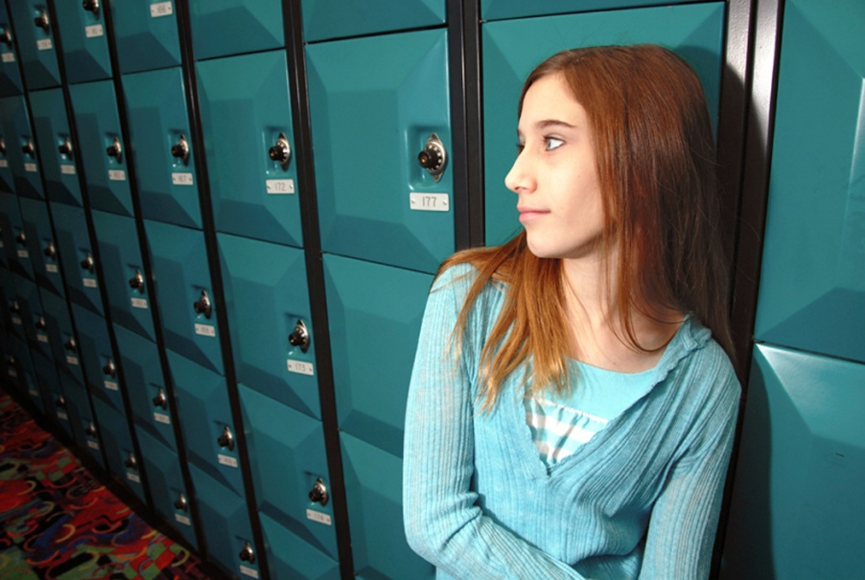
Access
Access to the district’s Internet is a privilege, not a right.
Users are expected to follow the teacher’s directions.
Noncompliance will result in suspension or termination of privileges, as well as any disciplinary action.

Slide 11

Do Not…
You should not load
  Viruses
  Software
  Games
on any district device.

Slide 12

Drives
You may access the student share drive
(S drive) or your student folder (G drive) to retrieve or save files.
Attempting to access other drives is strictly prohibited.
Noncompliance will result in disciplinary action.

Slide 13

Acknowledgement
When you login to a GCCISD device, clicking OK acknowledges that you have read and understand GCCISD’s rules and that noncompliance will result in suspension or termination of technology privileges and/or other disciplinary action.

Slide 14

Computer Don’ts…
Don’t eat or drink near the computer.
Don’t play with cords or pull them out.
Don’t use other people’s equipment or read their files without asking.
Don’t touch the screen on the monitor.

